Slide 1

Social Science Research Design and Statistics, 2/e
Alfred P. Rovai, Jason D. Baker, and Michael K. Ponton
Modifying Tables
PowerPoint Prepared by
Alfred P. Rovai
IBM® SPSS® Screen Prints Courtesy of International Business Machines Corporation,
© International Business Machines Corporation.

Slide 2
Modifying Tables
SPSS provides one the ability to modify tables that appear in any SPSS Output window.
Both table properties and cell properties can be changed.

Slide 3
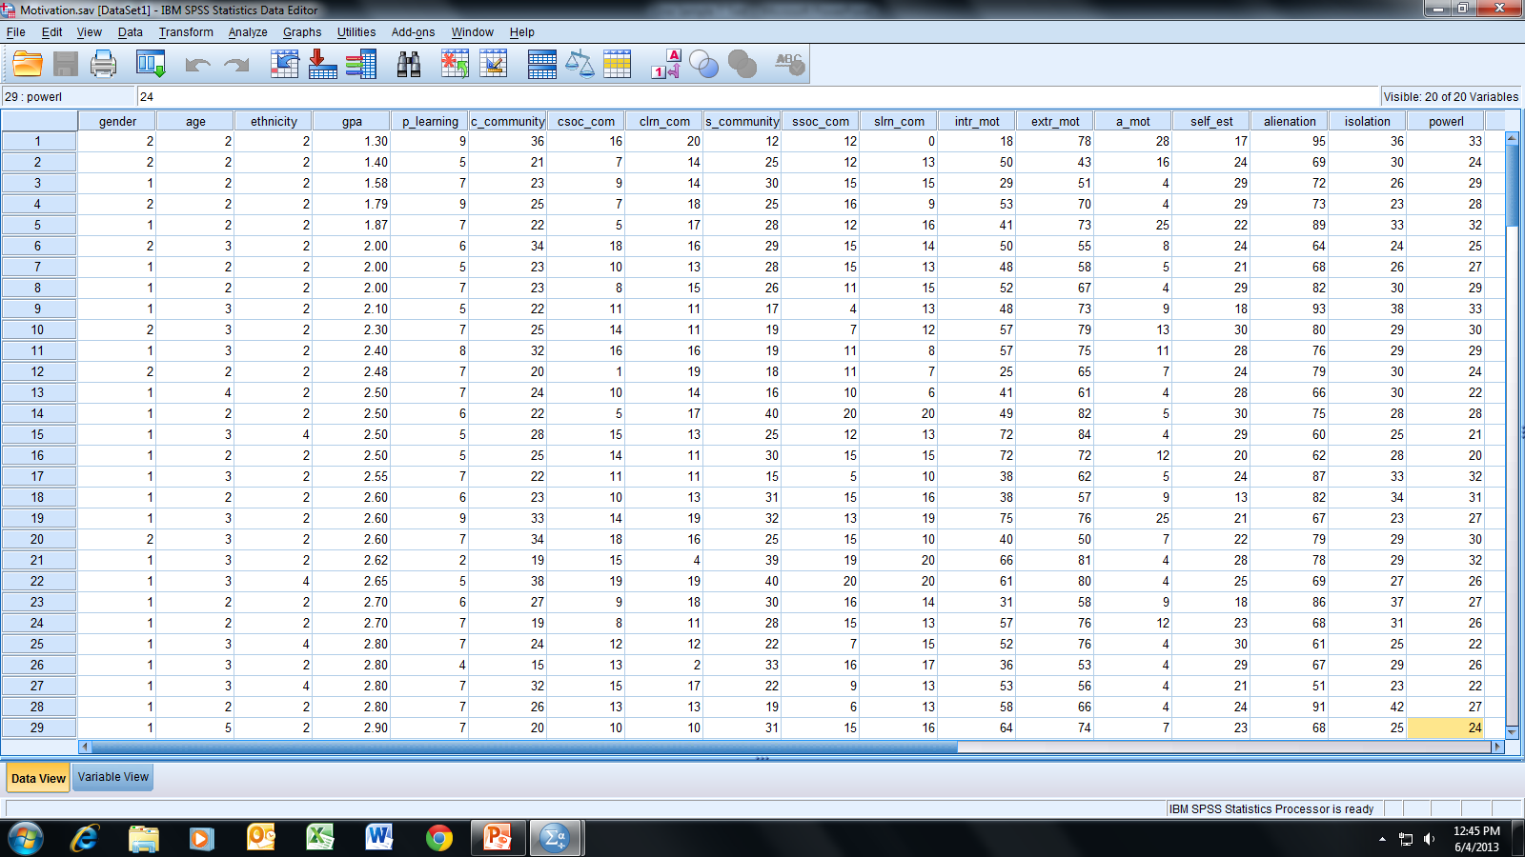
Open the dataset Motivation.sav.
File available at http://www.watertreepress.com/stats
TASK
Generate a descriptive statistics table for alienation disaggregated by gender and then modify the resultant table.

Slide 4
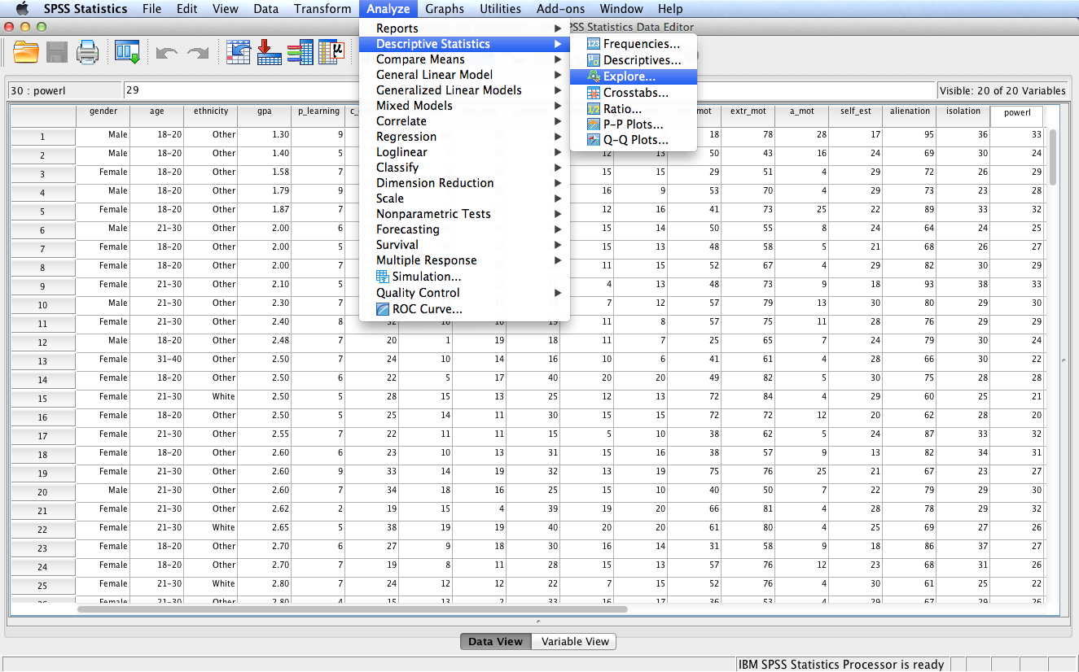
Follow the menu as indicated.

Slide 5
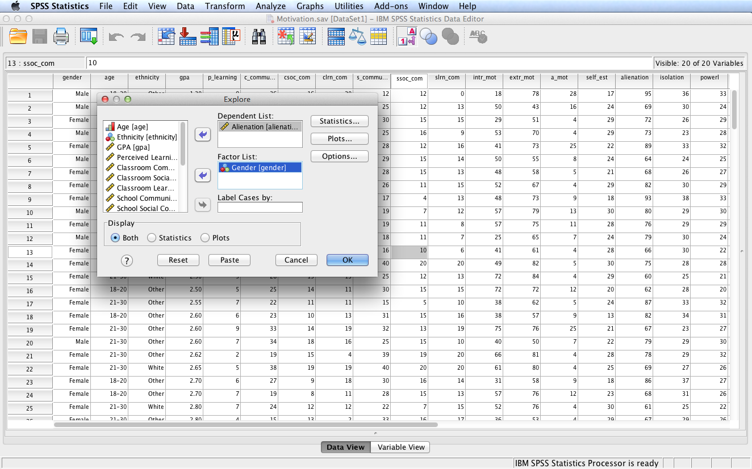
Move Alienation to the Dependent List: box and Gender to the Factor List: box. Click OK.

Slide 6
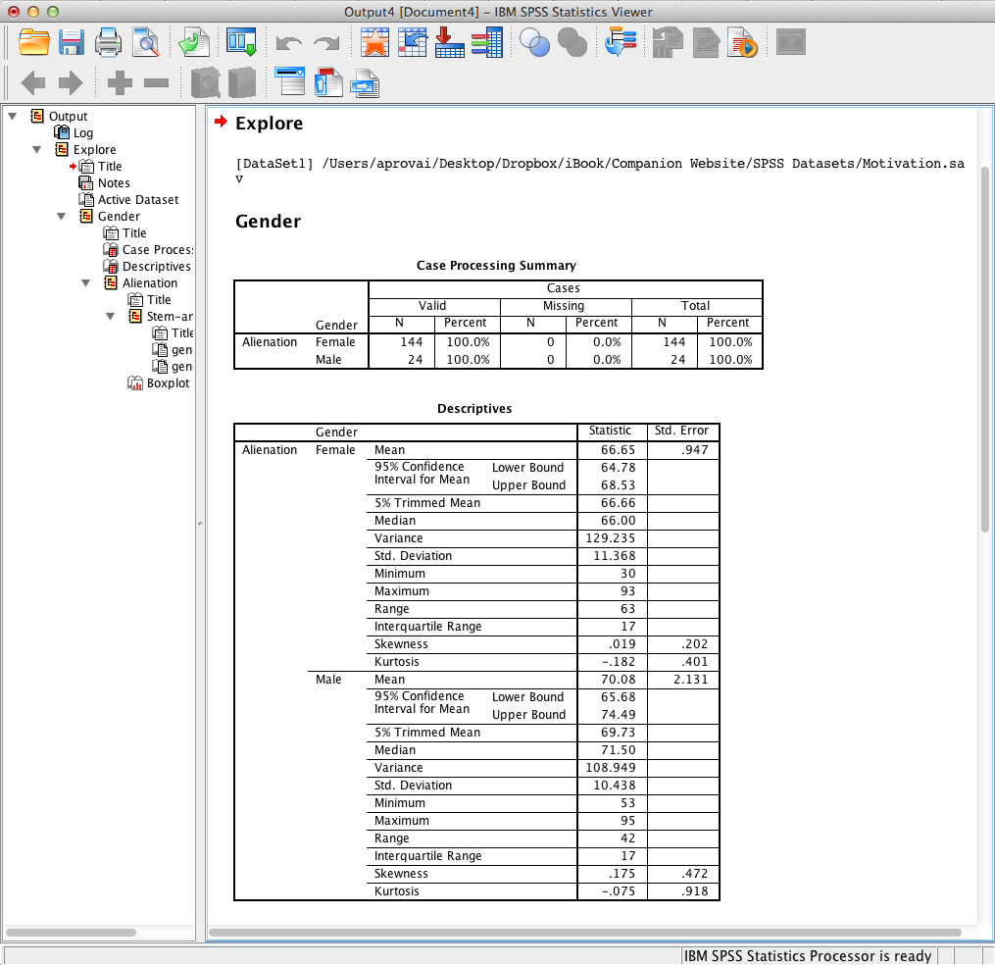
SPSS Output
Double-click the Descriptives table to enter edit mode.

Slide 7
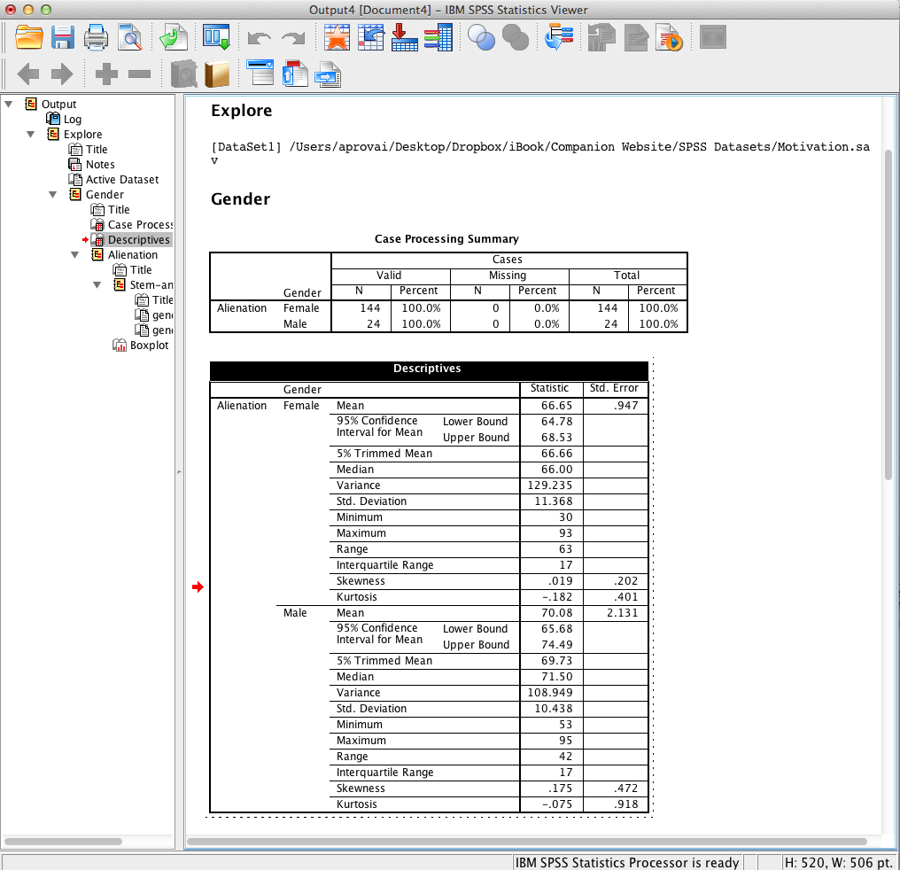
SPSS Output
The Descriptives table is in edit mode when surrounded by a dotted border. The tools on the menu bar are available to make changes to the table or to each cell.

Slide 8
SPSS Output
The Descriptives table is in edit mode when surrounded by a dotted border.

Slide 9
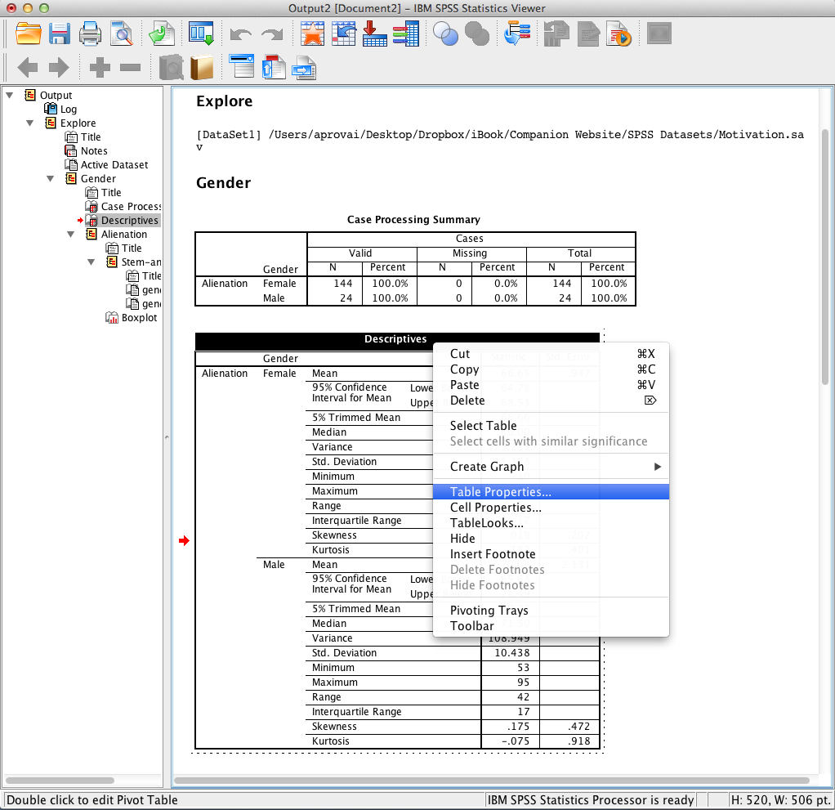
SPSS Output
Right-click the table in edit mode to display the edit menu. Select Table Properties.

Slide 10
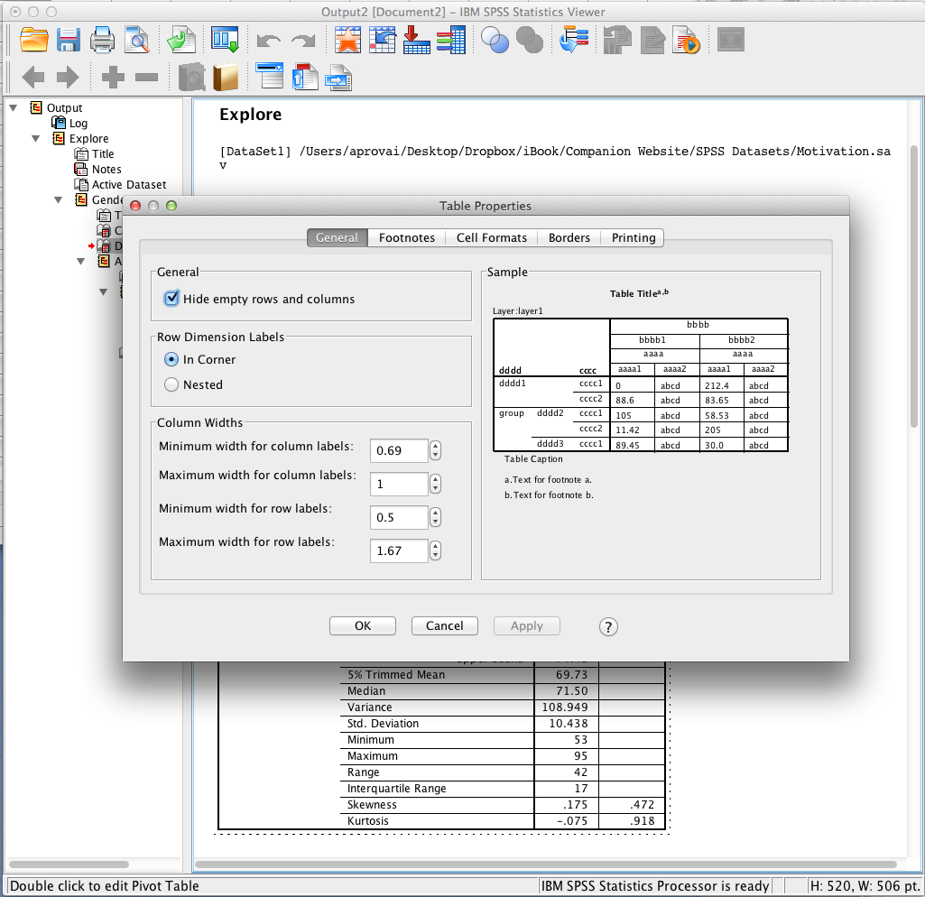
SPSS Output
The Table Properties dialog is used to make global changes to the table by first selecting the appropriate tab (General, Footnotes, Cell Formats, Borders, Printing) and then selecting specific changes. Selecting various options will display a preview of the change in the Sample area.
Note the In Corner option is selected for Row Dimension Labels.

Slide 11
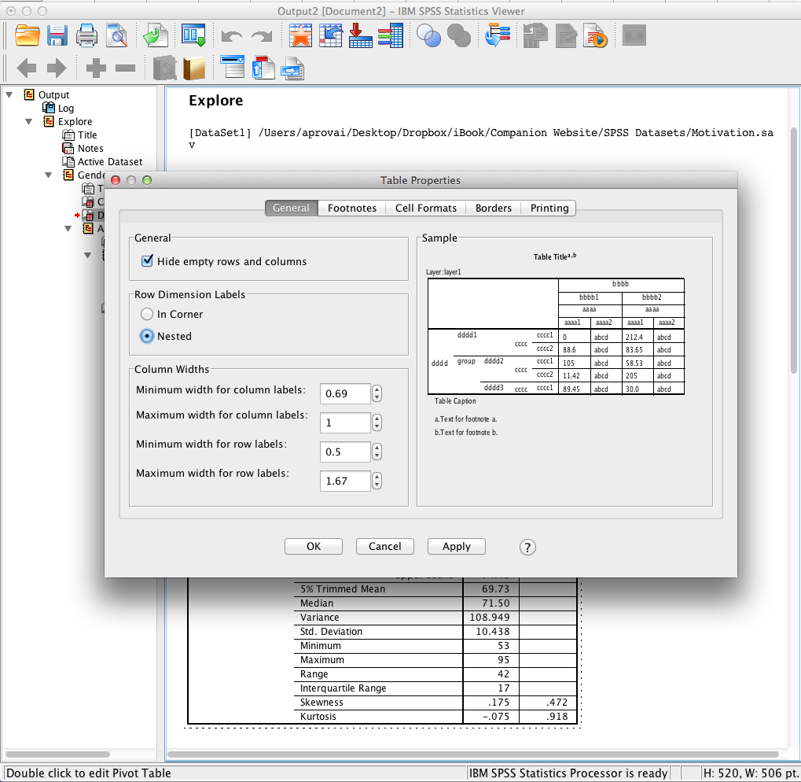
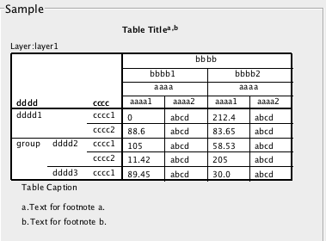
SPSS Output
Selecting Nested as the Row Dimension Label changes the table as shown in the Sample area to the left.
This graphic shows the Sample area with In Corner selected as the Row Dimension Label.

Slide 12
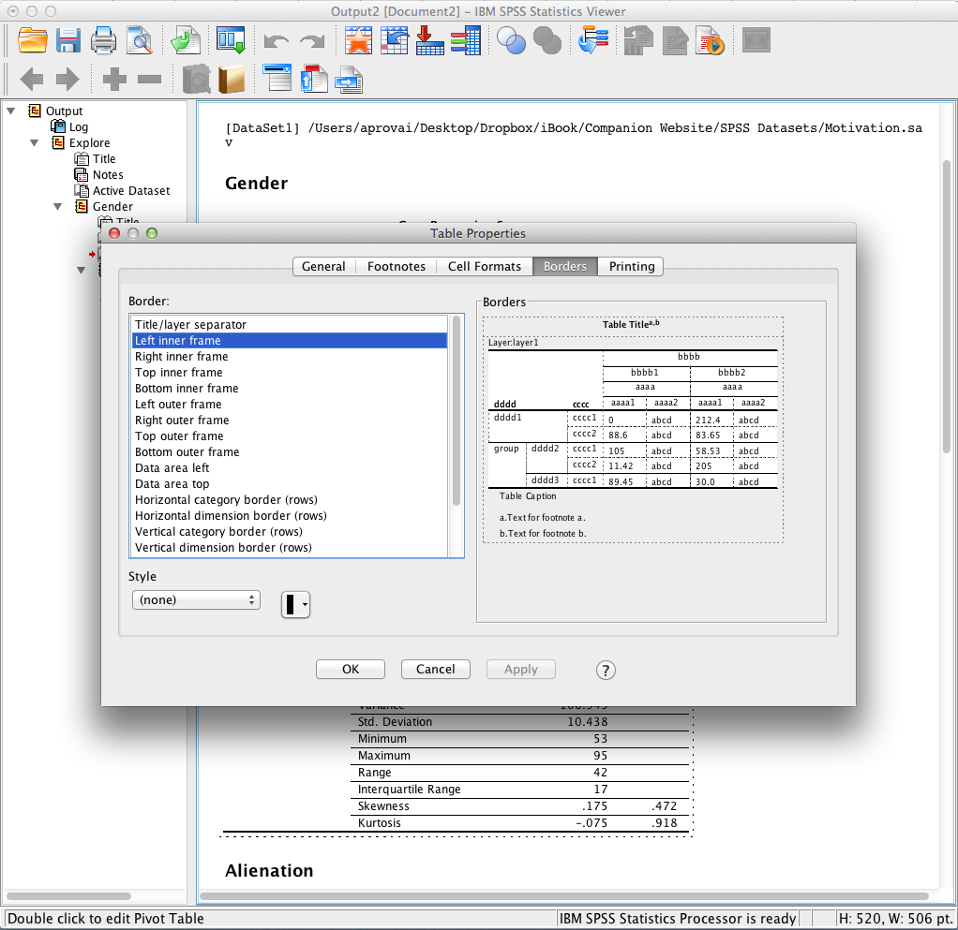
SPSS Output
Vertical lines can be removed if desired by selecting the border element and selecting (none) for Style.

Slide 13
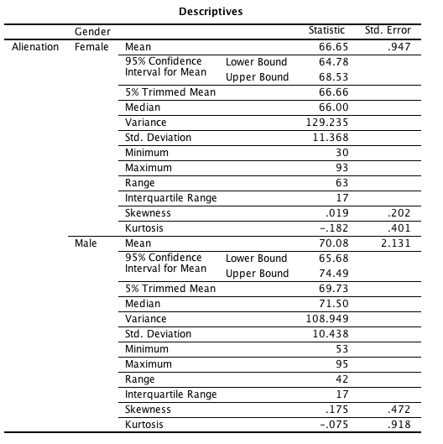
SPSS Output
Applying the changes results in the table to the left.

Slide 14
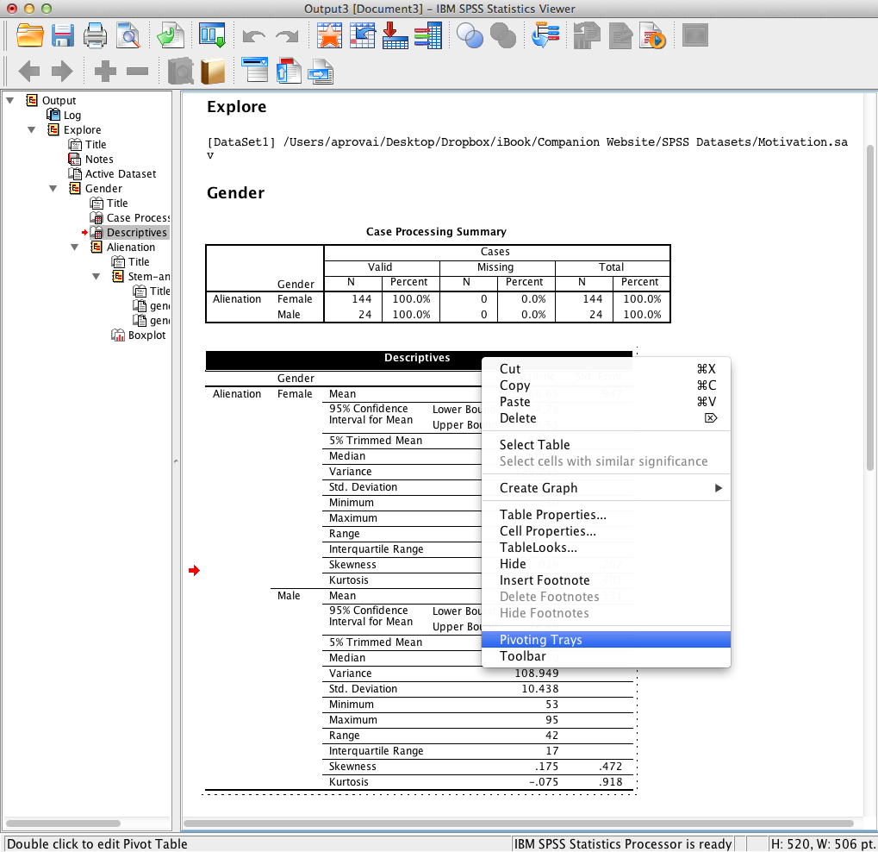
SPSS Output
Next, select Pivoting Trays.

Slide 15
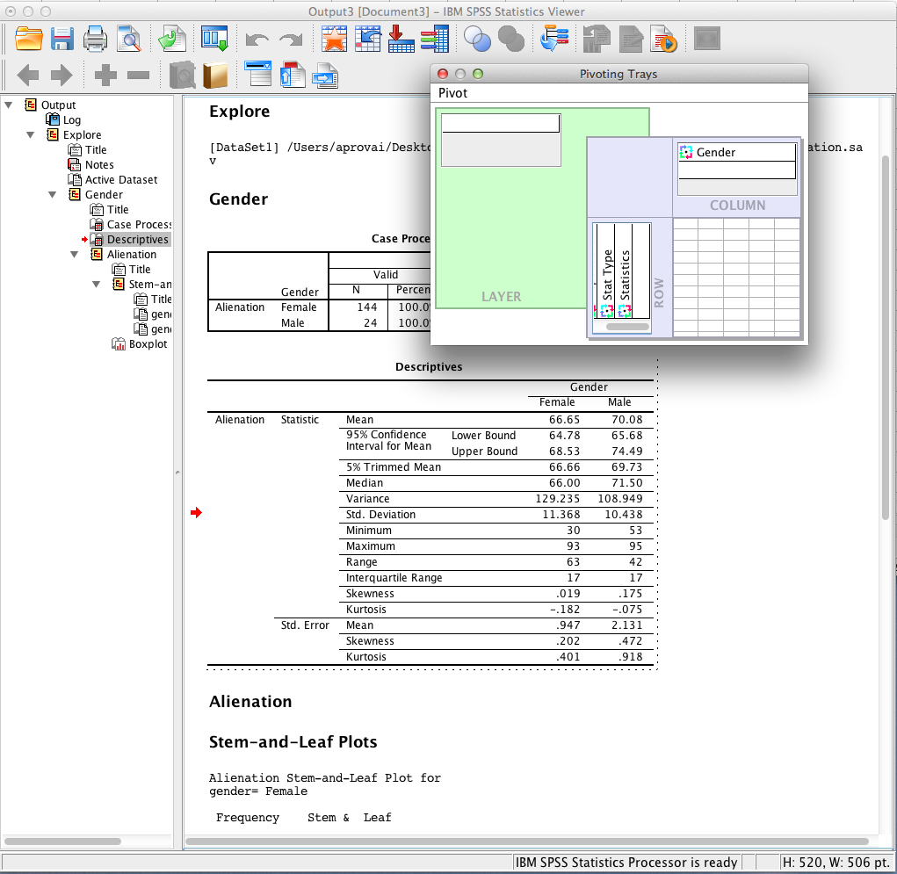
SPSS Output
Remove Stat Type from the column box by dragging it to the row box and then drag Gender from the row box to the column box. The result is shown at the left.

Slide 16
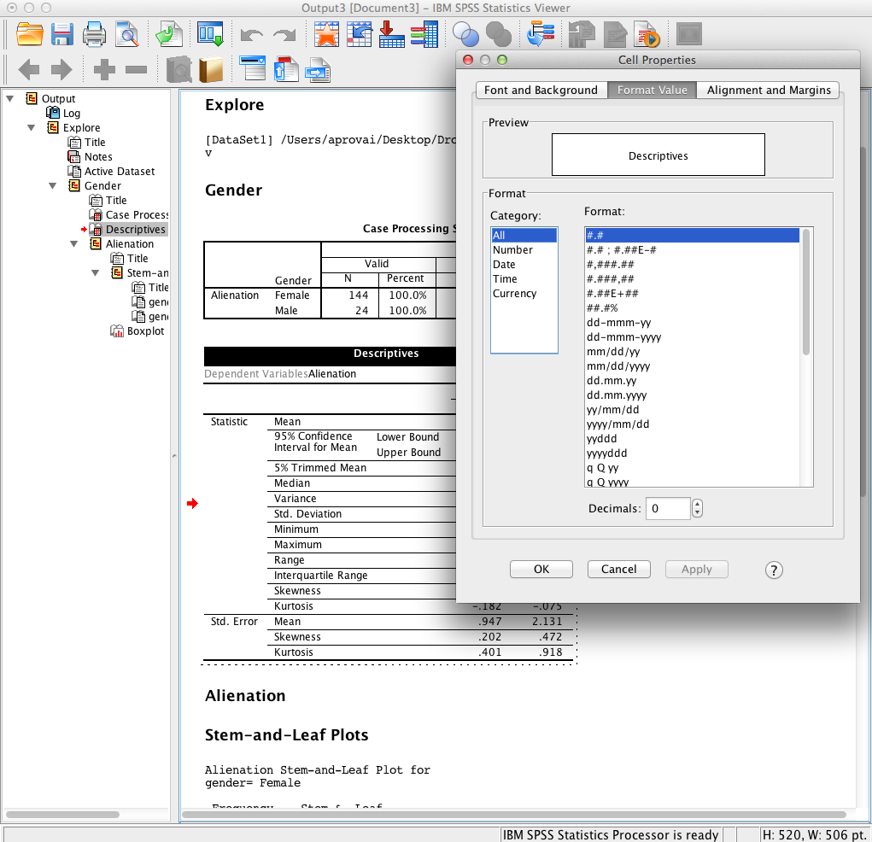
SPSS Output
Selecting Cell Properties displays the dialog box to the left. Changes can be made to fonts and background, format value, and alignment and margins.

Slide 17
End of Presentation

